Slide 1
“Discover Your True North”
Bill George
Senior Fellow, Harvard Business School
and former Chair & CEO of Medtronic
Construction Industry Roundtable
West Palm Beach, FL
November 8, 2017

Slide 2
Today’s Agenda
9:00 – 9:45 “Discover Your True North”
9:45 – 10:00 1:1 Share Your Story
10:00 – 10:20 Developing Next Gen Leaders
10:20 – 10:40 Table Discussion on: Developing Next Gen Leaders
10:40 – 11:00 Summary & Open Q&A

Slide 3
Today’s Challenges for Your Leaders
Your leadership in a volatile world
Competing for excellence
Developing leaders for the next era
Training workforce with required technical skills
Engaging with Millennial employees

Slide 5
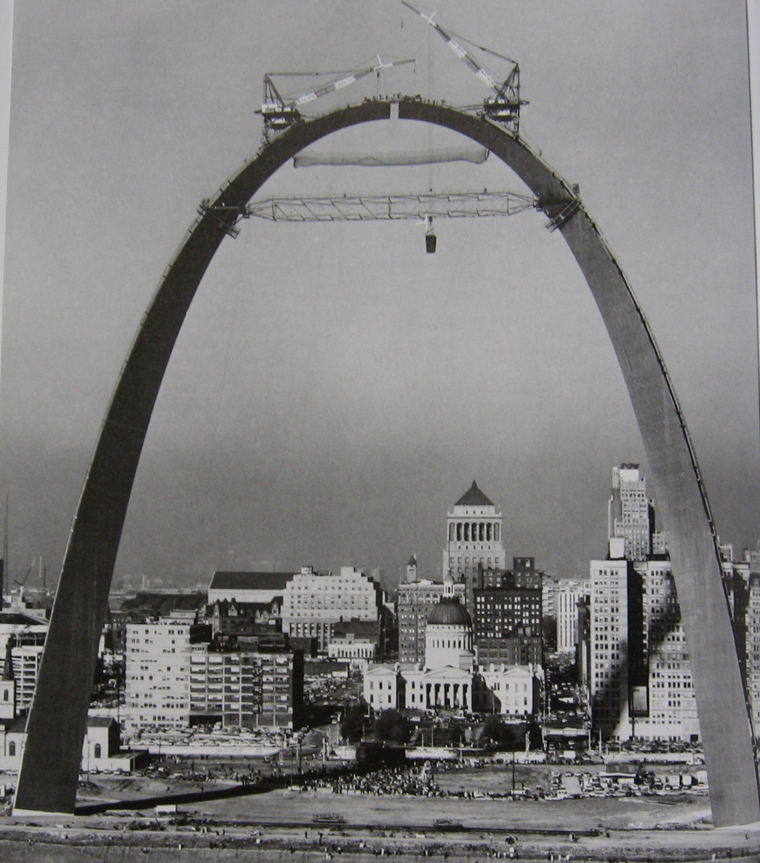

Slide 7
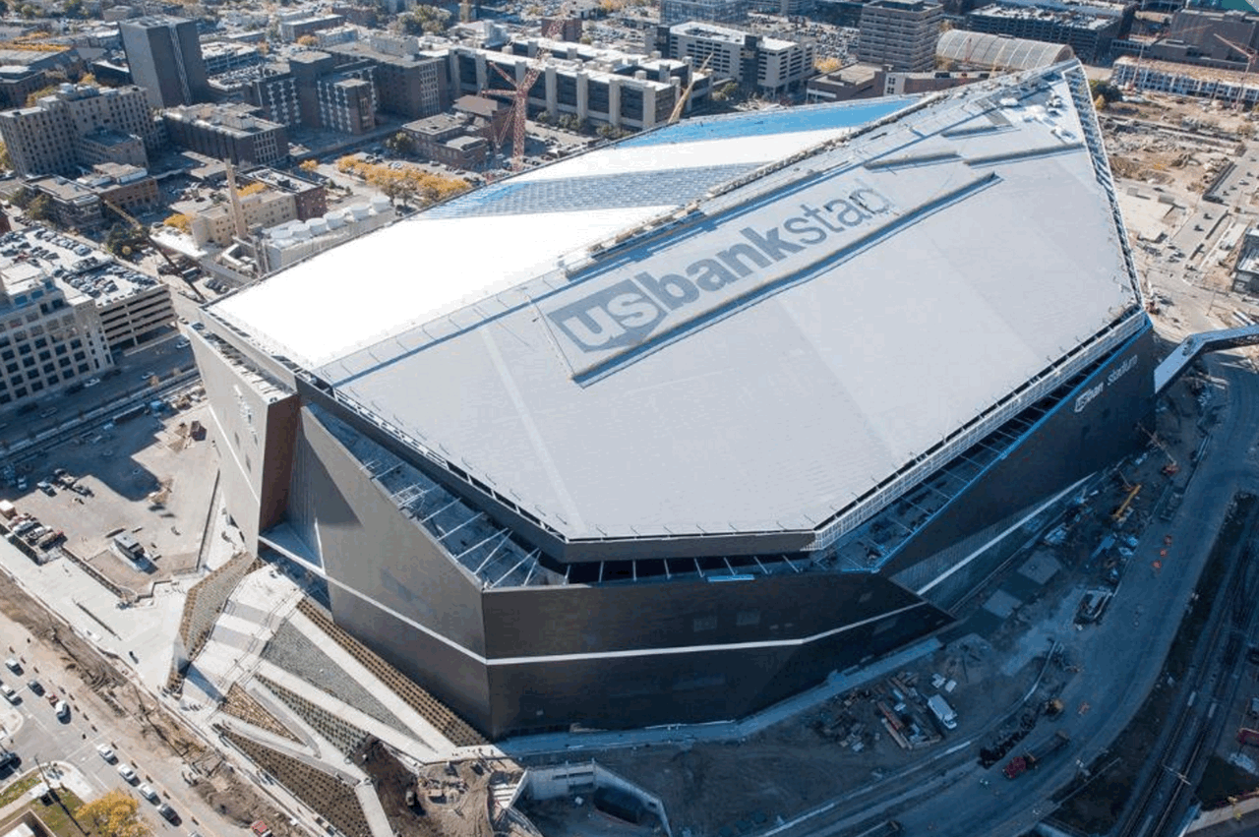

Slide 8
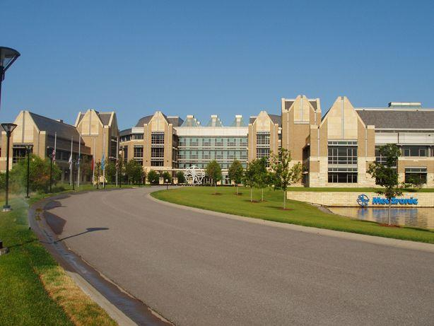

Slide 9
Leadership Is Changing
Hierarchical > Empowering
Bureaucratic > Interdependent Units
Limited Information > Transparency
Charisma & Style > Authentic & Open
Self-interest > Service to others
and greater cause
Impact of: Globalization
Technology & Social Media
Diversity
Millennials

Slide 10
Why Leadership Matters
Leadership makes the difference between success and failure of your organization
The root cause of numerous corporate meltdowns and failures in the last decade is failed leadership
Many failed leaders focused on short-term over long-term, placing their self-interest ahead of their institution’s interests.

Slide 11
Why Leaders Fail
Failed leaders did not fail due to lack of IQ
Rather they lacked emotional intelligence (EQ)
Lacked self-awareness
Unable to face reality & admit mistakes
Lacked passion for company’s mission & values
Lacked compassion and empathy for people
Lacked courage to transform organization

Slide 12
Definition of Authentic Leadership
Authentic leaders align people around shared mission and values
and empower them to lead,
while serving all stakeholders,
and collaborating with others
to sustain superior results

Slide 13
Your True North
“Your True North is the internal compass that guides you successfully through life. It represents who you are at your deepest level. Your True North is based on what is most important to you, your most cherished values, your passions and motivations, the sources of satisfaction in your life.”
- True North, Introduction

Slide 14
Staying on Course of Your True North
Your Most Deeply Held Beliefs, Values and Principles
How do you stay on course
in spite of pressures and seductions to deviate?

Slide 15
Your True North
Your Life Story
Your Crucibles
Your Defining Leadership Experience

Slide 16
Self-Disclosure Exercise
Pair off with a colleague
and share with each other:
Your Defining Leadership Experience

Slide 17
Developing Next Gen Leaders
Making the “I to We” Journey
Gaining Self-Awareness
Leading by Values
Your Sweet Spot
Your Support Team
The Integrated Leader

Slide 18
The “I to We” Journey
I Leaders
Get ahead
Attain power & position
Self-interested decisions
Do it on my own
I’m out front; Follow me
Compliance with rules
Arrogant
Direct others
Near-term results
Loyal followers
Leader gets credit
We Leaders
Be authentic
Serve others
Purpose-driven decisions
It takes diverse team
Work together for mission
Align through values
Humble
Coach & mentor others
Serve customers
Empower people to lead
Team gets credit

Slide 19
Gaining Self-Awareness
Reflection
Self-
Compassion
Your Life Story
Your
Crucible
Self-
Awareness
Self-
Acceptance
Self-
Actualization
Feedback

Slide 20
Reflection and Introspection
Create a daily practice of taking 20 minutes away from your 24/7 world for:
Meditation or mindfulness
Prayer
Walking or jogging
Journaling
Deep, intimate discussion
Reflecting in a quiet space

Slide 21
Feedback: “Breakfast of Champions”
Seek honest feedback from subordinates, peers, mentors, advisors and bosses
Open up your hidden areas
Discover your blind spots
Use 360 Feedback
Invite difficult conversations
Address conflict and sensitive subjects
“One of the hardest things to do is to see ourselves as others see us”

Slide 22
Values: What you do when no one is looking
New York Times Transparency Test
Prior to taking an action, ask yourself:
Would you feel comfortable if a transcript of this conversation was published in the New York Times?

Slide 23
Your “Sweet Spot”
Extrinsic
Motivations
Strengths
Sweet
Spot
Intrinsic
Motivations
Weaknesses

Slide 24
Extrinsic and Intrinsic Motivations
Extrinsic Motivations
Intrinsic Motivations
Money
Power
Titles
Public recognition
Social status
Acclaim from peers
Defeating others
Personal growth
Cherishing family
Satisfaction of doing well
Helping others develop
Finding meaning in work
Being true to one’s belief
Making difference in world

Slide 25
Strengths and Weaknesses
Often, your strengths and weaknesses are two sides of the same coin
Build on your strengths & minimize your weaknesses with people more capable
Acknowledge your weaknesses & ask for help
“Vulnerability is power”
You are in your “sweet spot” when you are:
Motivated intrinsically
In a job that utilizes your strengths

Slide 26
Your Support Team
Your support team consists of the following:
One person in your life with whom you can be completely open: your spouse, significant other, best friend, or therapist
Mentor(s) who can guide and counsel you and keep you from going off-track
A support group of your peers

Slide 27
Mentoring
Mentoring requires a two-way relationship, wherein both parties gain from interaction
What to look for in a mentor:
Wisdom, experience, support, chemistry
Putting mentee’s interests first
A challenging relationship
Reverse mentoring by Millennials
Understand younger generation
IT, social media, digital interaction

Slide 28
The Integrated Leader
Personal
Life
Work
Life
The
Integrated
Leader
Family
Life
Community Life

Slide 29
Nobel Peace Prize Albert Schweitzer
“I don't know what your destiny will be, but one thing I do know:
The only ones among you who will be really happy are those who have sought and found how to serve.”

