Slide 1
Trump, Taxes, Tariffs, & The 2018 Midterm Election
Daniel Clifton
May 2018
Macro Research
Investment Strategy
Economics
Policy Research
Quantitative Research
Technical Research
Fixed Income Research
Industry Surveys
Bespoke Research
Conferences
Sales & Trading

Slide 2
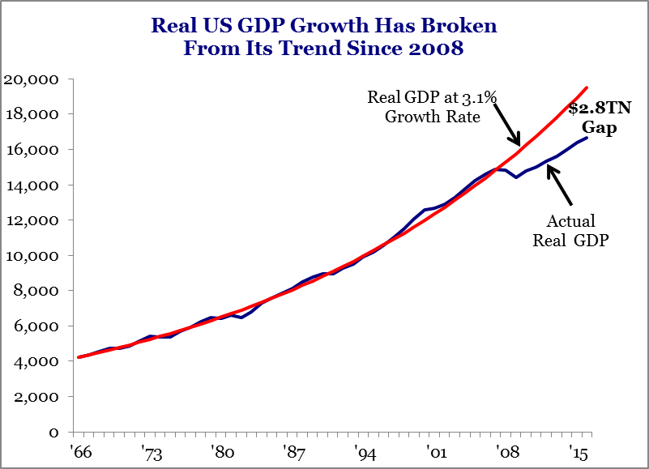
Economic Volatility Is Translating
Into Political Volatility
Something Just Broke In 2008 & The US Has Transitioned From A 3% to a 2% Growth Rate. Voters Know There Is Something Wrong

Slide 3
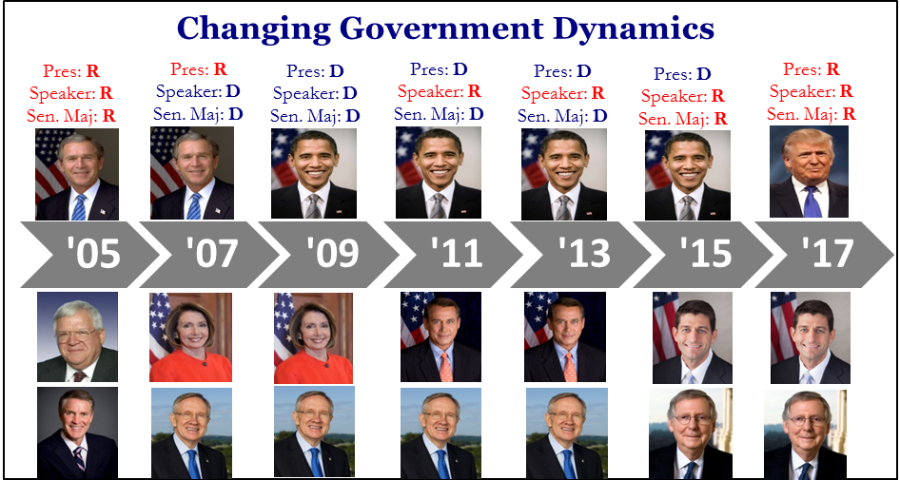
Voters Have Removed The Party In Power In 5 of the Past 6 Elections

Slide 4
The Kevin Hassett Victory Lap:
But Is It Enough?

Slide 5
Democrats Are An Early Favorite To Regain Control of the House

Slide 6
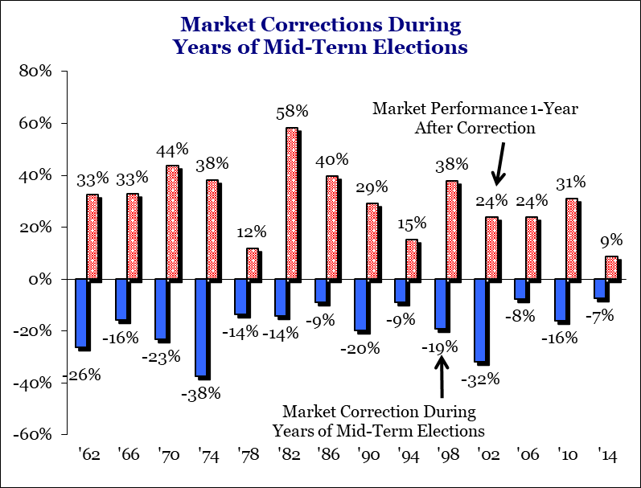
Average Midterm Election Year Decline Is 18% For The S&P 500

Slide 7
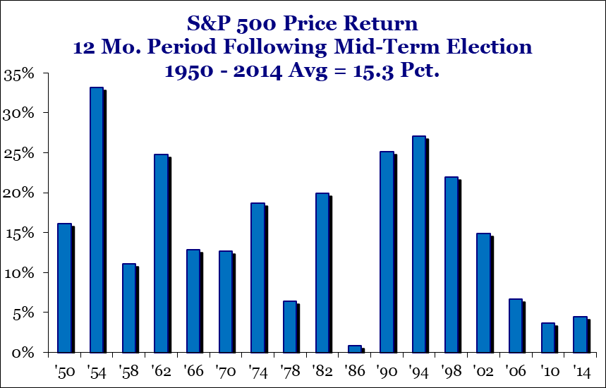
S&P 500 Has Not Declined In The 12 Months Following Midterm Since ‘46

Slide 8
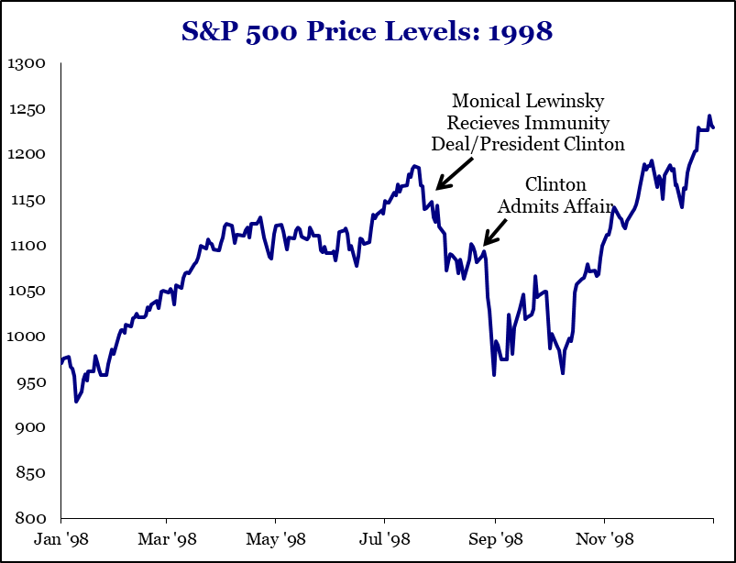
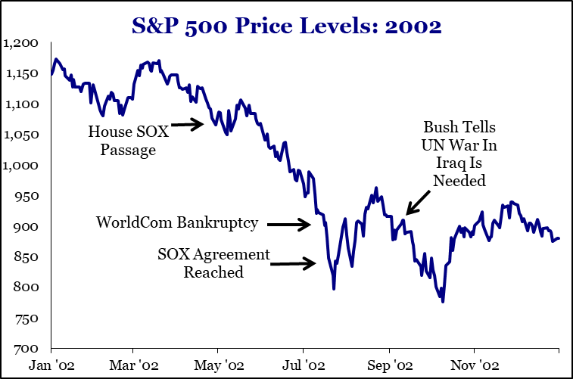
Midterm Election Years Usually Have A Policy Event Trigger A Sell Off

Slide 9
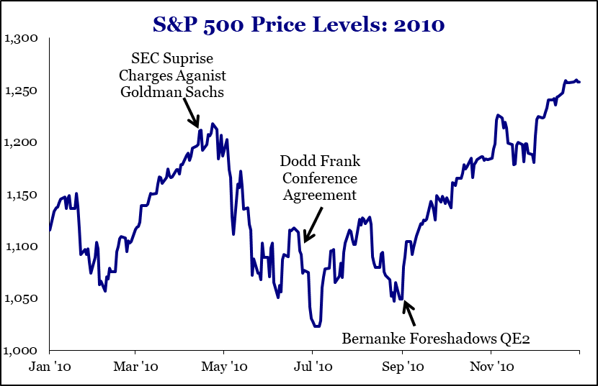
Midterm Election Years Usually Have A Policy Event Trigger A Sell Off

Slide 10
2018 Has A Combination of ‘98, ‘02, ‘06 & 10 Midterm Events At Once
Impeachment: Mueller Investigation of the President Is Intensifying
Sarbox: Trade Has Similar Effect On Earnings
Geopolitical Risk: Syria, N. Korea, Iran
Key Sector Regulation: FANG

Slide 11
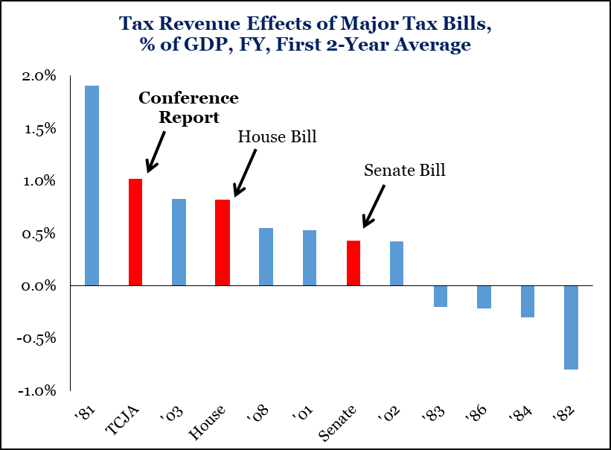
The Good News: Tax Cuts & De-Regulation Are Already In Place

Slide 12
Shock & Awe Fiscal Policy
CY Fiscal Stimulus From Tax Reform & New Spending, $BN
 | 2018 | 2019 | 2020 | 2021
Individual & Small Business Tax Cuts | -122.5 | -184.4 | -168.0 | -150.8
Domestic Corporate Tax Cuts | -162.8 | -128.6 | -107.8 | -50.4
International Corporate Tax Changes | 79.6 | 38.5 | 26.5 | 22.9
Tax Cut In Spending Bill | -13.4 | -1.3 | -2.2 | -0.8
New Spending | -103.0 | -155.0 | -57.1 | -11.0
Total Tax Cuts + Spending | -321.7 | -429.5 | -308.6 | -190.1
CBO CY GDP Forecast | 20,118 | 20,847 | 21,566 | 22,378
Stimulus % of GDP | -1.60% | -2.10% | -1.43% | -0.85%

Slide 13
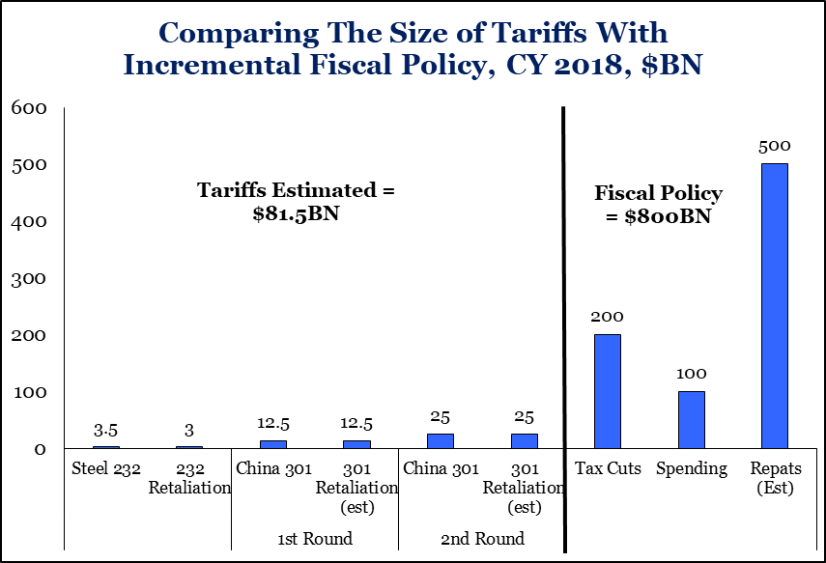
Fiscal Stimulus In CY 2018 Dwarfs The Size of Tariffs On The Table

Slide 14
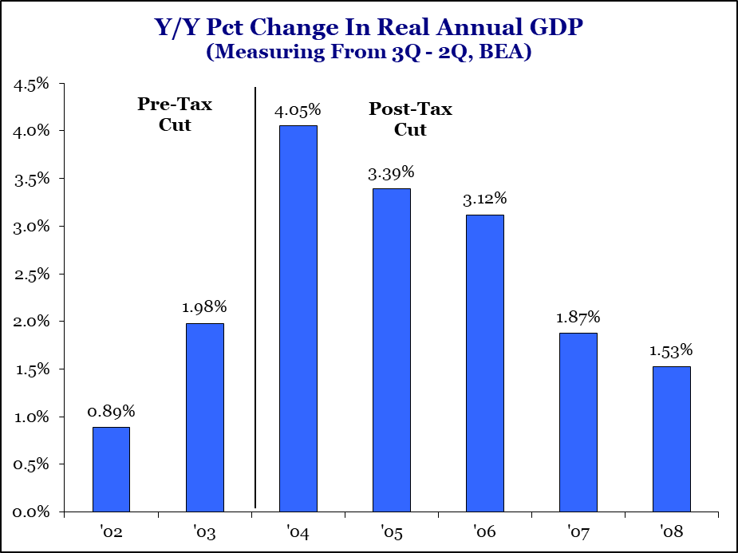
Upon Passage, The Question Will Be Whether This Will Impact Growth

Slide 15
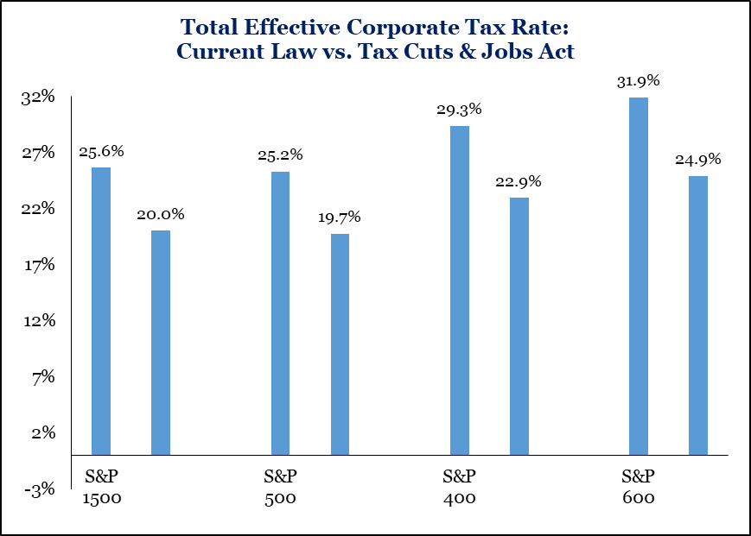
Earnings Boosted $10-14 Per Share On The S&P 500

Slide 16
Construction & Engineering Companies Benefit From Tax Reform

Slide 17
Companies Are Announcing New Plans for Capital Expenditures

Slide 18
Repatriation Could Add Another $500 to $700 Billion of Tax Cuts In 2018

Slide 19
Already, 30% of the Tax Cut “Cost” Has Been Recouped

Slide 20
Yields & Dollar Moving Just Like Post-2003 Tax Cut

Slide 21
Equity Markets Do Not
Like Trade Wars

Slide 22
More Companies Are Citing Concerns About Tariffs/Costs In Earnings Calls

Slide 23
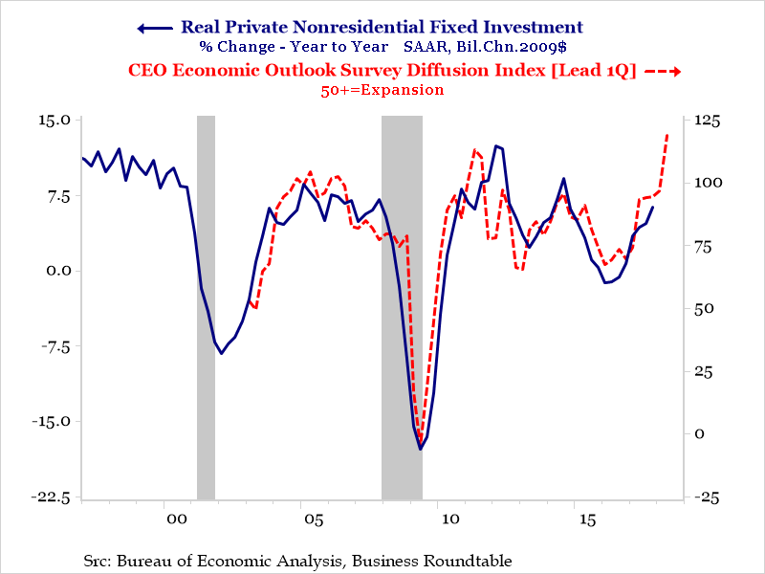
Concern: Trade Tensions Could Reduce Confidence & Investment

Slide 24
Capex Plans Are Rolling Over Since Tariff Discussion Started

Slide 25
Cap Ex Needed: Lots of Jobs But Not Much Growth For The Jobs

Slide 26
Financial Markets Are Ratcheting Down Growth Expectations

Slide 27
In All Four Previous Trade Decisions, Trump Has Compromised A Lot

Slide 28
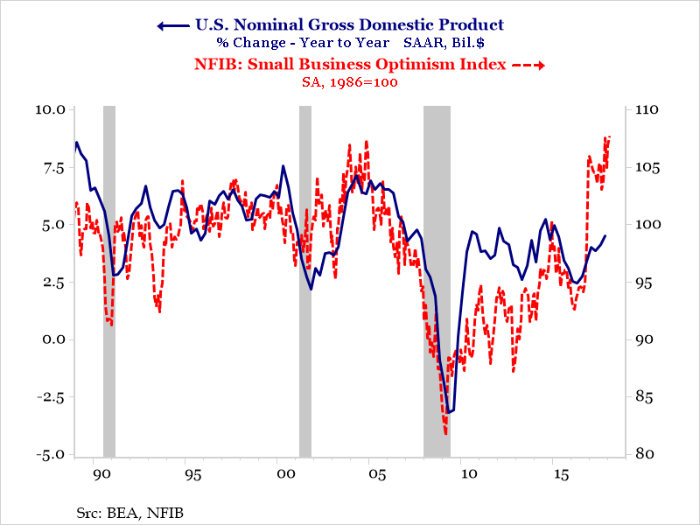
Despite Headwinds, We See US Economic Growth Accelerating

Slide 29
The Fed Is Now More Worried About Inflation Than Deflation

Slide 30
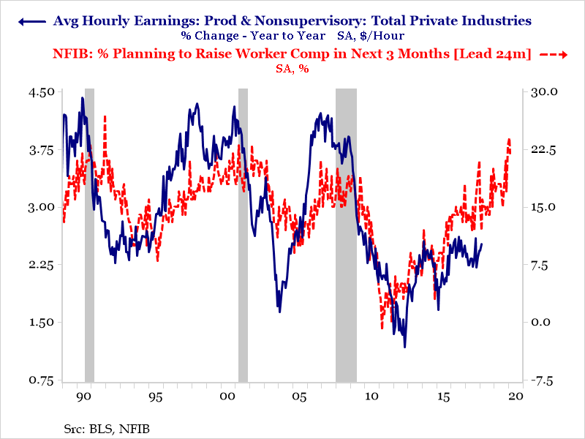
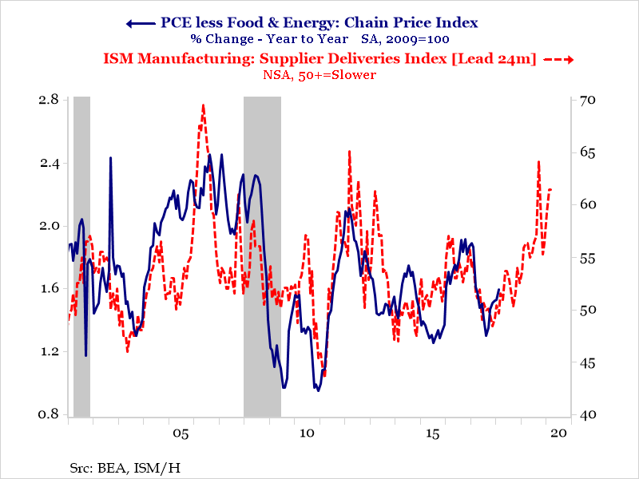
The Fed Is Now More Worried About Inflation Than Deflation

Slide 31
Likely To See A Little Bit More Wage Inflation, Less Commodity Inflation

Slide 32
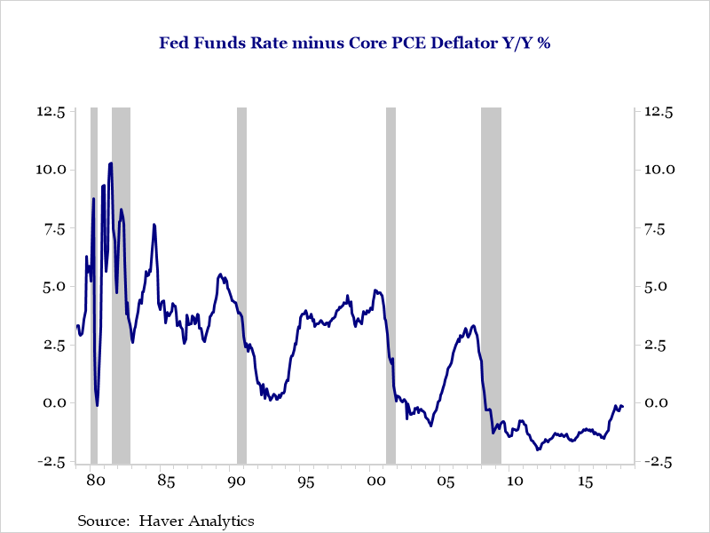
The Fed Is Currently Not Tightening, Just Keeping Up With Inflation

Slide 33
1st Midterm Elections Have Not Been Kind To Incumbent Presidents

Slide 34
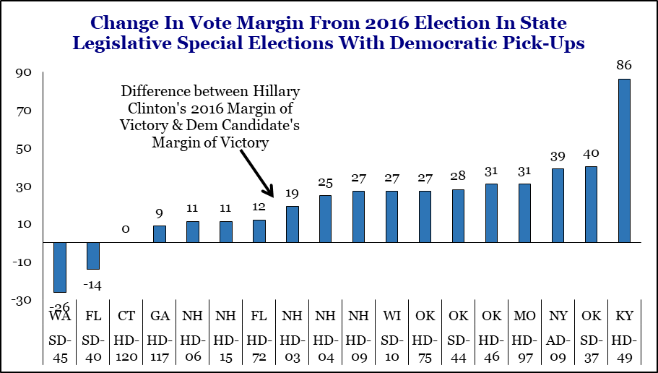
Dems Have Flipped 39 GOP State Legislative Seats, 20 Trump Districts

Slide 35
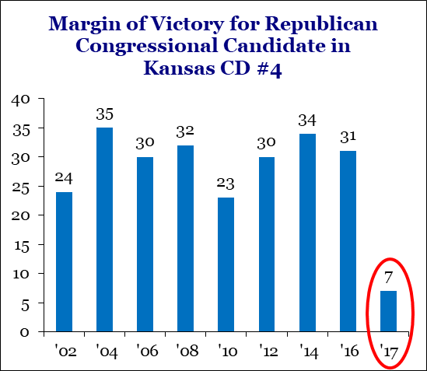
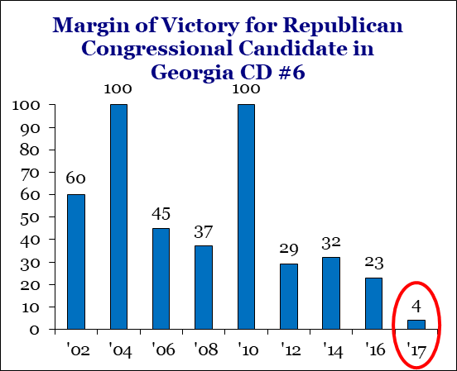
Nearly 75% of Dems Are Coming Out To Vote But Just 50% of Republicans

Slide 36
Republicans Have Been Improving On The Critical Generic Ballot
The Republican improvement on the generic ballot in the past few weeks has been striking. This could be a temporary blip but if it continues to trend lower the losses may not be as great as was the case a month or two ago.

Slide 37
Could Mueller Save The GOP?

Slide 38
Infrastructure Companies May Get A Boost From A Democratic Win

Slide 39
Highest Conviction Investment Idea

Slide 40
Appendix: Important Disclosures
This communication was prepared by Strategas Securities, LLC (“we” or “us”) and is intended for institutional investors only. Recipients of this communication may not distribute it to others without our express prior consent. This communication is provided for informational purposes only and is not an offer, recommendation or solicitation to buy or sell any security. This communication does not constitute, nor should it be regarded as, investment research or a research report or securities recommendation and it does not provide information reasonably sufficient upon which to base an investment decision. This is not a complete analysis of every material fact regarding any company, industry or security. Additional analysis would be required to make an investment decision. This communication is not based on the investment objectives, strategies, goals, financial circumstances, needs or risk tolerance of any particular client and is not presented as suitable to any other particular client. The intended recipients of this communication are presumed to be capable of conducting their own analysis, risk evaluation, and decision-making regarding their investments.
For investors subject to MiFID II (European Directive 2014/65/EU and related Delegated Directives): We classify the intended recipients of this communication as “professional clients” or “eligible counterparties” with the meaning of MiFID II and the rules of the UK Financial Conduct Authority. The contents of this report are not provided on an independent basis and are not “investment advice” or “personal recommendations” within the meaning of MiFID II and the rules of the UK Financial Conduct Authority.
The information in this communication has been obtained from sources we consider to be reliable, but we cannot guarantee its accuracy. The information is current only as of the date of this communication and we do not undertake to update or revise such information following such date. To the extent that any securities or their issuers are included in this communication, we do not undertake to provide any information about such securities or their issuers in the future. We do not follow, cover or provide any fundamental or technical analyses, investment ratings, price targets, financial models or other guidance on any particular securities or companies. Further, to the extent that any securities or their issuers are included in this communication, each person responsible for the content included in this communication certifies that any views expressed with respect to such securities or their issuers accurately reflect his or her personal views about the same and that no part of his or her compensation was, is, or will be directly or indirectly related to the specific recommendations or views contained in this communication. This communication is provided on a “where is, as is” basis, and we expressly disclaim any liability for any losses or other consequences of any person’s use of or reliance on the information contained in this communication.
Strategas Securities, LLC is affiliated with Robert W. Baird & Co. Incorporated (“Baird”), a broker-dealer and FINRA member firm, although the two firms conduct separate and distinct businesses. A complete listing of all applicable disclosures pertaining to Baird with respect to any individual companies mentioned in this communication can be accessed at
http://www.rwbaird.com/research-insights/research/coverage/third-party-research-disclosures.aspx. You can also
call 1-800-792-2473 or write: Robert W. Baird & Co., PWM Research & Analytics, 777 E. Wisconsin Avenue, Milwaukee, WI 53202.

Slide 41
DISCLAIMER: The model investment portfolios discussed in this report have been developed and maintained by Strategas Securities, LLC. Strategas Securities licenses the portfolios to its affiliate, Strategas Asset Management, LLC, an investment adviser, which either provides the model portfolios to other managers with investment discretion, or manages client accounts directly in a manner that tracks the composition of one or more of the model portfolios. Strategas Securities does not selectively distribute its research reports to any particular customer or class of customers – including its affiliates – in advance of other customers that are entitled to receive the report.
NEW YORK | WASHINGTON, DC | COLUMBUS, OHIO
52 Vanderbilt Avenue | 1775 I Street, NW | 88 E. Broad Street
8th Floor | Suite 420 | Suite 1180
New York, NY 10017 | Washington, DC 20006 | Columbus, OH 43215
United States | (202) 223-7644 | (614) 221-6680
(212) 906-0130 | (202) 223-7647 fax
(212) 906-131 fax
info@strategasrp.com

