Slide 1
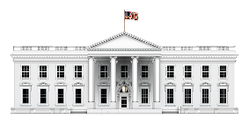
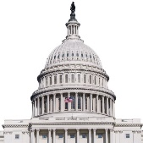
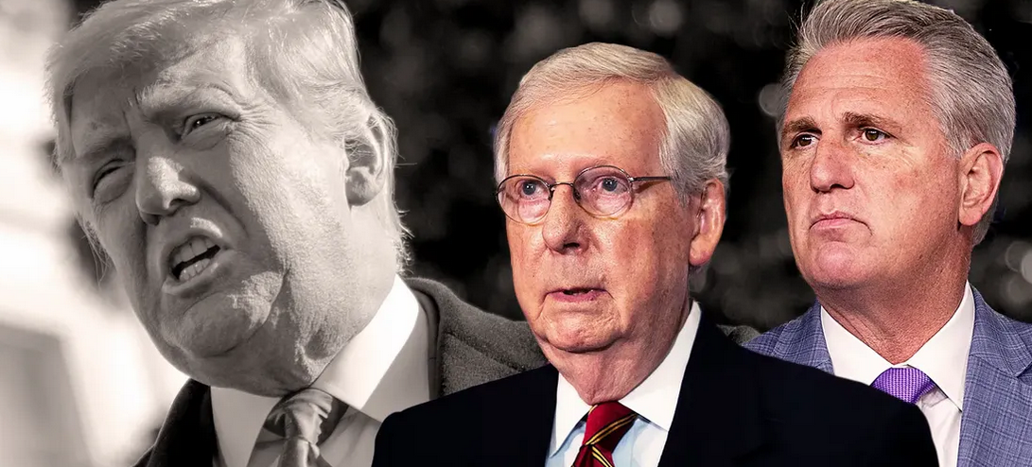
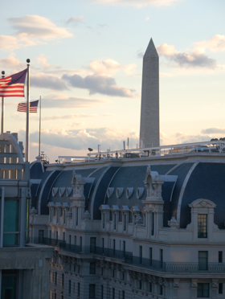
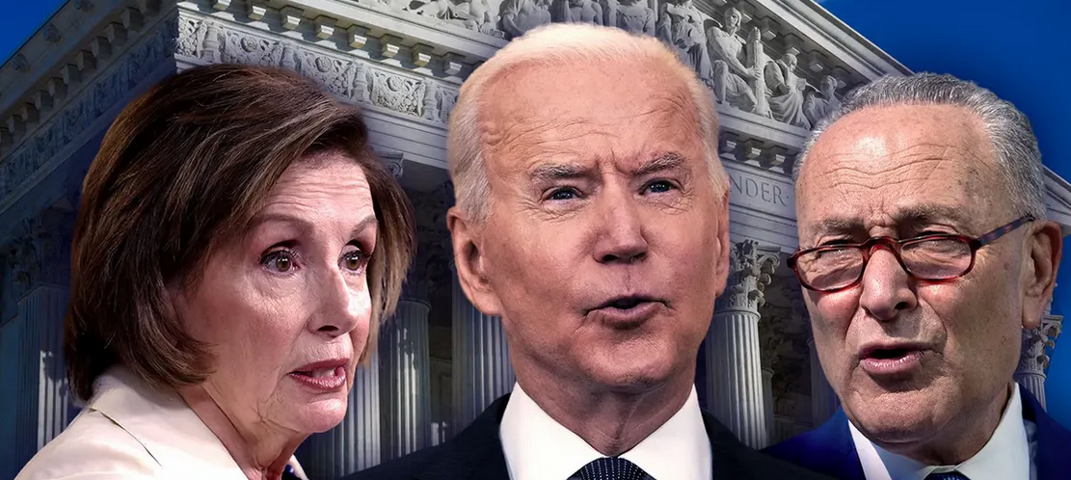
Bruce Mehlman
April 25, 2023
7 for ‘23
Key Policy / Political Trends in the Year Ahead

Slide 2
SUMMARY
7 Key Trends for 2023
2022 Election lessons
Congressional Confrontations return
Executive Branch action will accelerate
Deglobalization & Decoupling
“Woke Wars” & Patchwork Quilts
Progress will persist
2024 Campaign Begins

Slide 3
#1. Where We Start
2022 Midterm Elections:
Outcomes & Implications

Slide 4
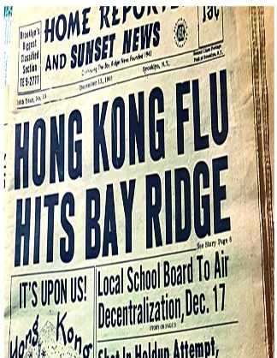
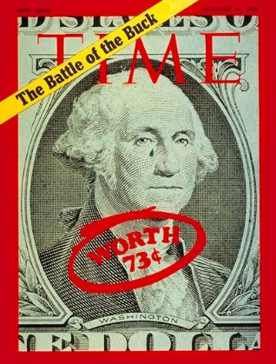
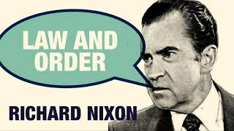
HISTORICALLY, VOTERS SEEK POLITICAL STABILITY AMID DISRUPTION
Global War | Public Health Crisis | Crime & Racial Violence | Domestic Political Violence | Economic Fears | Voters Seek Less Chaos More Stability
Early
1920s
Late
1960s

Slide 5
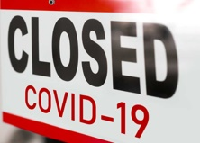
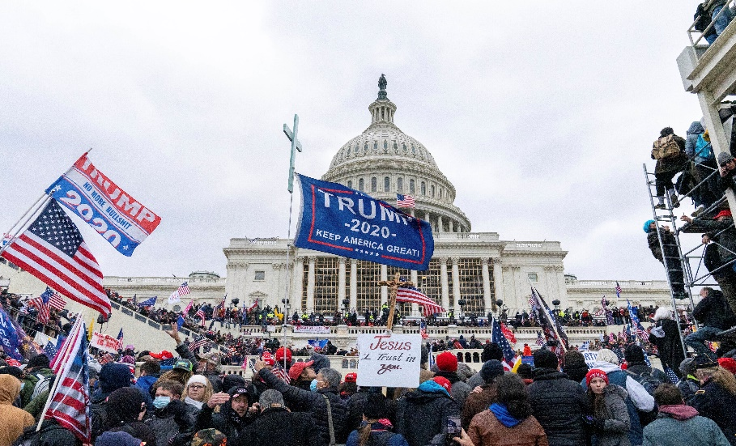
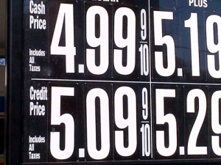
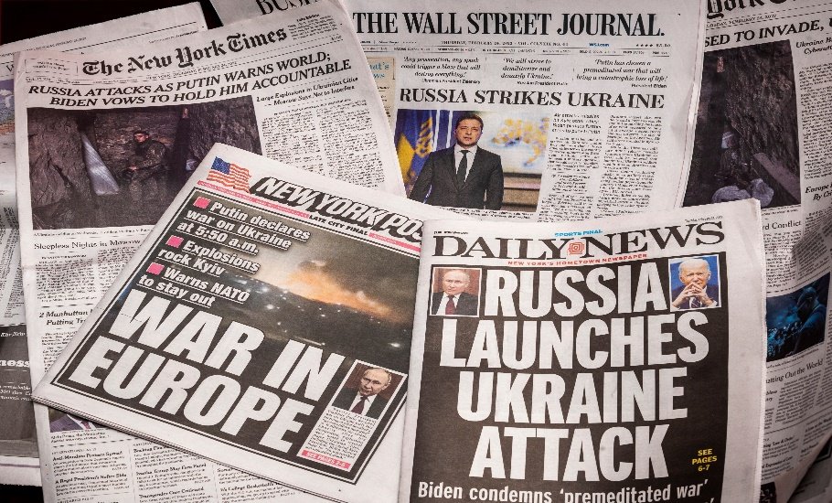
IN 2022, VOTERS WERE VERY DISRUPTED / STRESSED OUT
SYSTEMS FAILED
INSTITUTIONS FAILED
LEADERSHIP FAILED
ECONOMIC ANXIETY
SOCIAL ANXIETY
GEOPOLITICAL ANXIETY

Slide 6
VOTERS STUCK WITH LEADERS THEY KNEW… “FLIGHT TO SAFETY”
Seeking Stability at a Time of Heightened Anxiety
Incumbent Reelection Rates, 2022
SENATORS
100%
28/28
GOVERNORS
96%
27/28 (NV)
HOUSE
97.5%
356/365

Slide 7
RED STATES WENT RED, BLUE STATES WENT BLUE
TRUMP 2020 Presidential Margin BIDEN
HI
VT
Republicans won 17 of 17 Trump 2020 States
MD
WA
CA
CO
IL
CT
NY
NH
OR
AZ
GOP 2022 Senate Margin DEM
AZ
PA
GA
NV
NC
WI
OH
Democrats won 15/16 Biden 2020 States
(All but WI)
AR
UT
MO
IA
FL
KY
IN
KS
SC
OK
ID
ND
AL
SD
LA

Slide 8
#2. Divided Government
Return of the Confrontational Congress

Slide 9
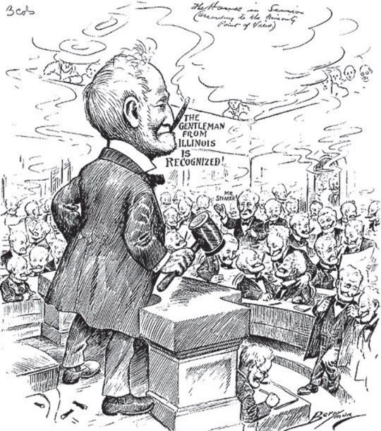
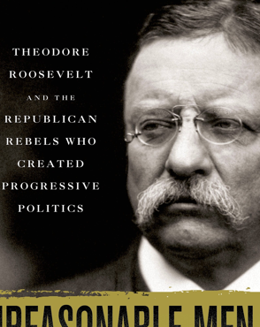
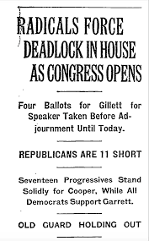
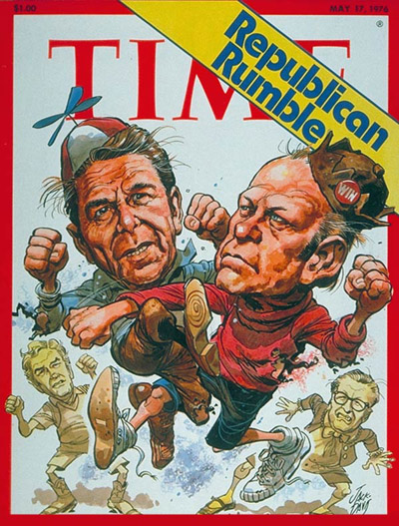
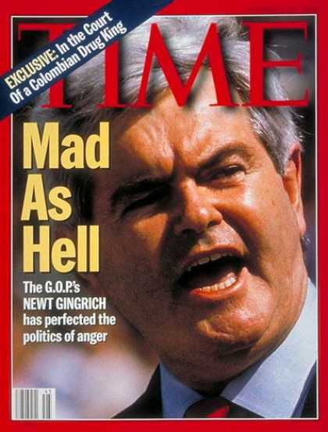
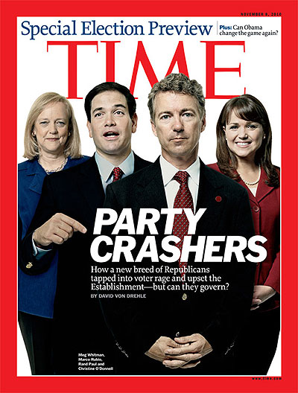
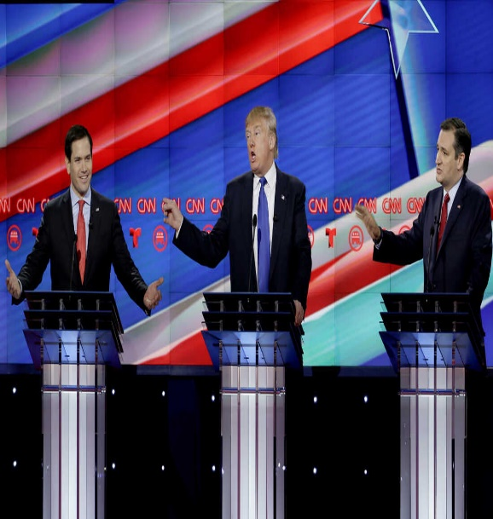
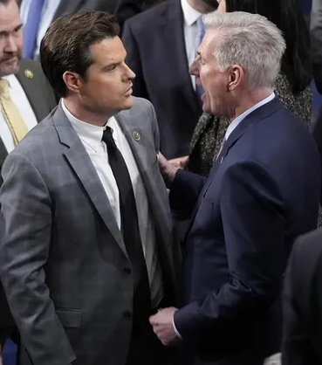
GOP REBELS ARE ALWAYS ATTACKING THE ESTABLISHMENT
YES, GOP “REBELS” ARE ATTACKING ESTABLISHMENT LEADERS
1910
1912
1923
1976
1994
2010
2016
2023

Slide 10
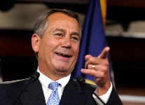
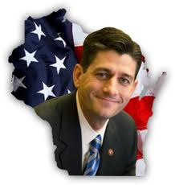
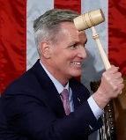
NARROWER MAJORITIES EMPOWER FACTIONS
Republican Majorities
Democratic Majorities
Source: House

Slide 11
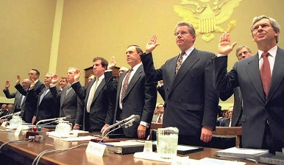
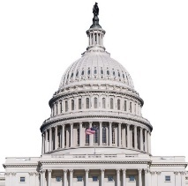
OVERSIGHT WILL GO INTO OVERDRIVE
Competing Committees Aiming to Score Points, Send Messages
DEMOCRATS* |  | REPUBLICANS
1. Trump Admin & Business |  | 1. Biden Family & Admin
2. Voting Rights |  | 2. Weaponized Gov’t (FBI, IRS)
3. “Anti-Union” CEOs |  | 3. “Woke” CEOs
4. China Collaborators |  | 4. China Collaborators
5. Falsehoods Online |  | 5. Free Speech/Censorship Online
6. Regulatory Under-Enforcement |  | 6. Regulatory Over-Reach
7. COVID Profiteering |  | 7. COVID Origins / Fauci
8. Climate (Oil CEO’s) |  | 8. Climate (Wall St CEOs / ESG)
9. Refugee Maltreatment |  | 9. Inability to Control Border
10. Extremism in the Ranks |  | 10. “Woke” Military Leaders
* 51 seats means Senate Dems gained partisan subpoena power.

Slide 12
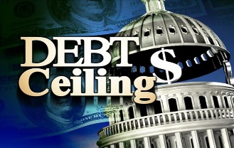
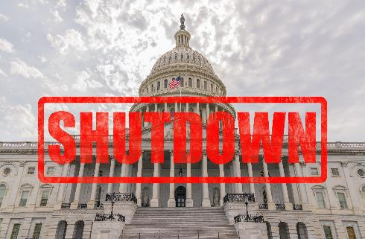
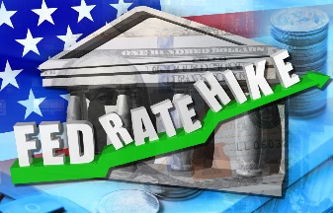
FISCAL FIGHTS COMING… USUALLY FOLLOW CRISIS SPENDING
Crisis Spending
Crisis Spending
Annual Federal Spending (M)
Annual Federal Spending (M)
Austerity Hangover
Austerity Hangover
Extraordinary Economics of 2020-22 → ‘23 Backlash
U.S. Nat’l Debt +31.6%
Crisis Spending
Annual DISCRETIONARY Federal Spending (T)
Austerity Hangover (Sequestration)
Fed’l Spending +42.5%
U.S. Inflation 40 year-high
Source: White House Budget Office

Slide 13
#3. Executive Branch
Full Speed Ahead
Regulation, Implementation & Enforcement

Slide 14
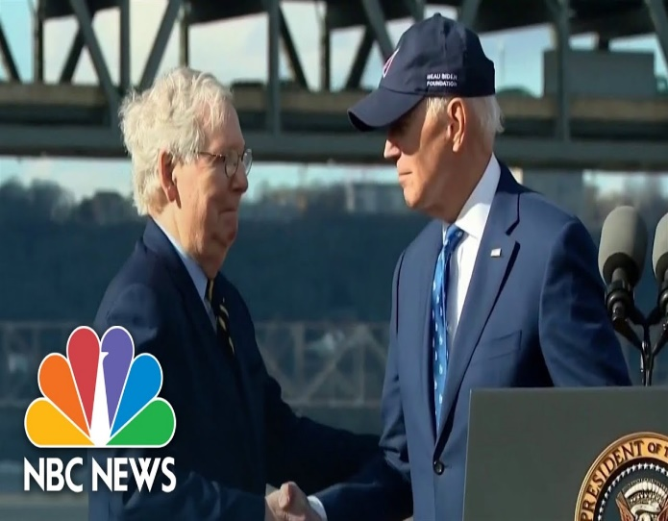
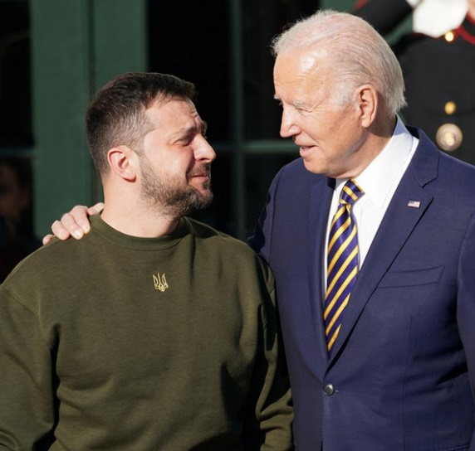
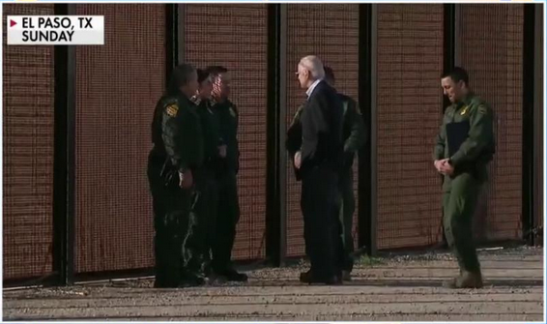
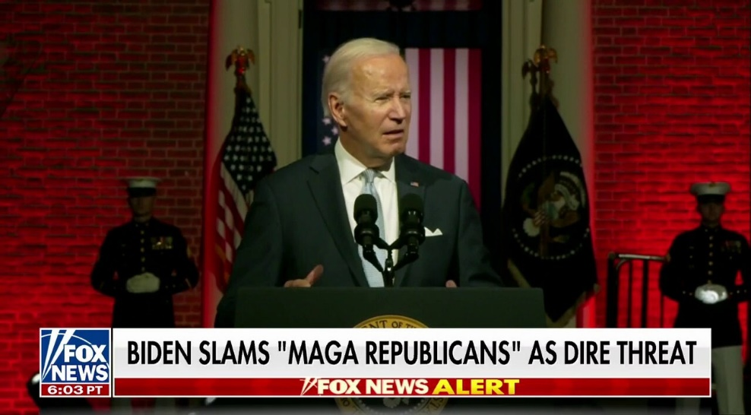
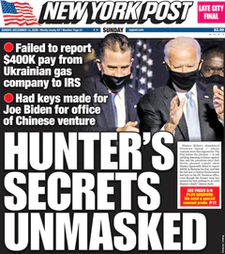
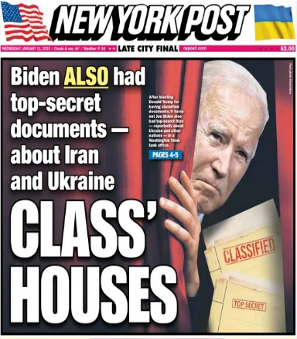
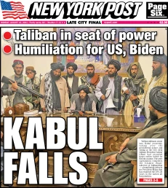
PRESIDENT BIDEN: “Triangulation Lite”
Highlight Popular, Bipartisan Leadership
Tack to the Center on Key Issue(s)
Run Against “Extremists” Foil
Navigate Oversight & Investigations

Slide 15
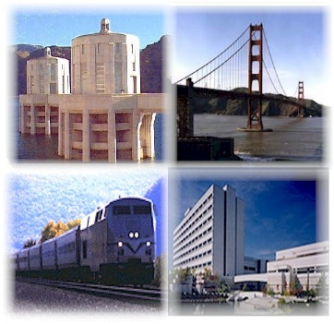
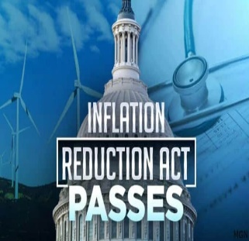
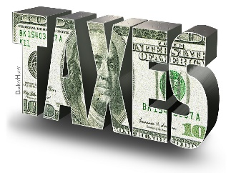
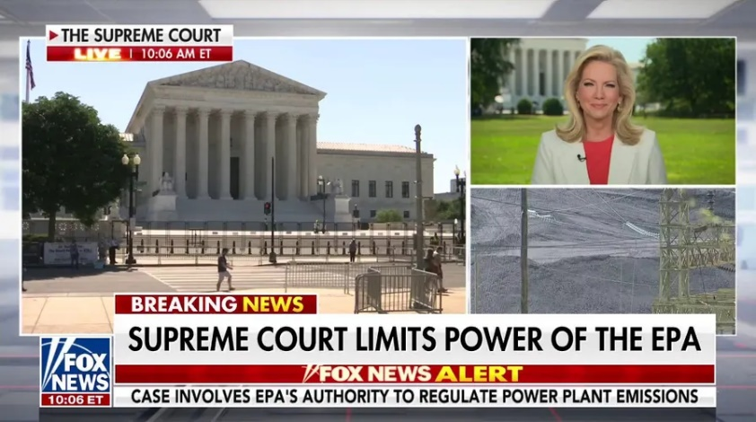
EXECUTIVE BRANCH & AGENCY HEADS: “Advance the Agenda”
Implement 2021-22 Laws
Accelerate Regulation
Bipartisan Infrastructure Law
CHIPS & Science Act
$1.2T
$280B
$1.22T
Increase Enforcement
Defend Actions & Authorities in Court

Slide 16
#4. Global Challenges
Geopolitical & Economic Frictions Driving Deglobalization

Slide 17
SUPPLY CHAINS WILL REMAIN CHALLENGED
1989-2019: Tailwinds Prevailed
2020- : Headwinds Rising
Tech-Enabled
Tech-Threatened
US-China Engagement
US-China Decoupling
Rising Globalization
Rising Nationalism
Shareholder-Driven
Stakeholder-Resisted
Prioritizing Efficiency
Prioritizing Resilience
Disinflationary Environment
Costs Rising (Labor, Energy, Goods)

Slide 18
CHINA CRACKDOWN WILL DRIVE PAIN… AND OPPORTUNITY
BUSINESS PAIN
Tighter Tech Export Controls
Outbound Investment Restrictions
Limits on Cross-Border Data
Propaganda Transparency & Ban
Supply Chain Decoupling
Defense Deals & Strategy
Human Rights Liability
BUSINESS OPPORTUNITY
Domestic Supports (eg CHIPS)
On- / Near-Shoring Incentives
Help vs Unfair Competition
New Regional Economic Alliances
Military Buildup & Contracts
Infrastructure Improvements
Stronger IP Enforcement
Watch: House Select Committee; Executive Orders

Slide 19
#5. “Woke Wars”
State-Led Culture Clashes Creating Political Pressures on C-Suites, ESG

Slide 20
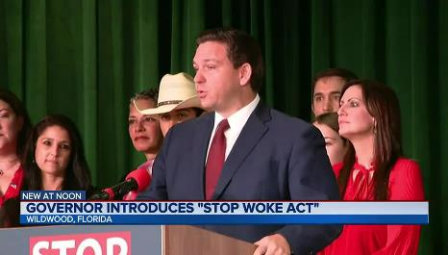
“WOKE” WARS WILL EXPAND, ESG WILL GET HARDER
Business Leaders Started Speaking Out on Social & Cultural Issues
ENVIRONMENTAL
SOCIAL
GOVERNANCE
Allied Coal > Russian Gas
Nations Punishing Activists
Pushback vs Fund Managers
States Penalizing Activism
Lawsuits
Tougher Standards Set & Enforced
Energy Inflation
More Divisive Issues,
Harder to Avoid
Business Pressures

Slide 21
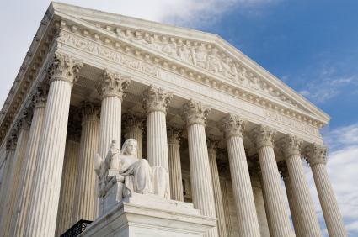
THE BIG SORT + SUPREME COURT = THE UNTIED STATES OF AMERICA
39 State Govt Trifectas
(One Party Control, Most in 40 Years)
SCOTUS Expanding States’ Rights, Limiting Feds
Patchwork Quilt Will Grow: Red States vs Blue States
ECONOMICS
Taxes
Unionization
Minimum wage
CIVIL RIGHTS
Guns
LGBTQ
Elections
Immigration
Education & DEI
TECH POLICY
Privacy
Censorship/Bias
Gig Work Classification
HEALTH CARE
Abortion
Vax Mandates
Paid Sick Leave
Medicare Exchanges
CLIMATE/ENERGY
Permitting
EVs & Gas cars
ESG investment
Source: Ballotpedia, 01/10/2022

Slide 22
#6. The Path for Progress
More Will Get Done Than You Think (especially if you expect little!)

Slide 23
THE 117th CONGRESS GOT A LOT DONE
Reports of the Death of Bipartisanship are Greatly Somewhat Exaggerated
HOUSE VOTE | SELECTED LEGISLATION IN 117th CONGRESS | SENATE VOTE
221-201 | INFRASTRUCTURE: II&JA | 69-30
243-193 | GUNS: BSCA | 65-33
363-70 | DEFENSE: FY ‘22 NDAA | 88-11
342-92 | POSTAL: PSRA | 79-19
369-40 | CIVIL RIGHTS: Anti-lynching law | Unanimous
243-187 | CHINA: Chips & Science Act | 64-33
258-169 | FREEDOM: Respect for Marriage Act | 61-36

Slide 24
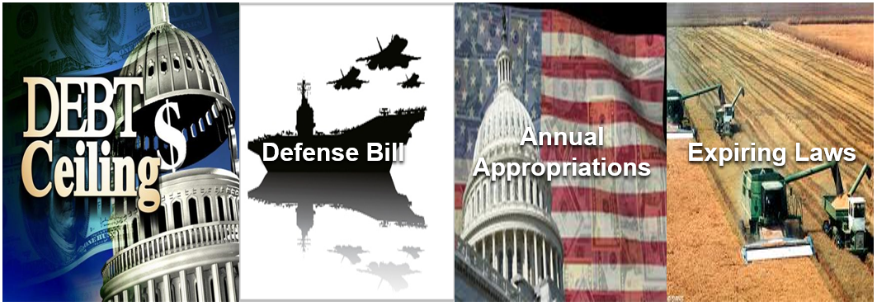
THE 118th CONGRESS HAS A LOT TO DO
What They Must Do
What They Want to Do
What They (Often) Agree On
What They Know They Should Do
Preparedness, Resilience & Recovery

Slide 25
#7. 2024 Begins
The Next Election is (Always) Coming, Influencing 2023 Action

Slide 26
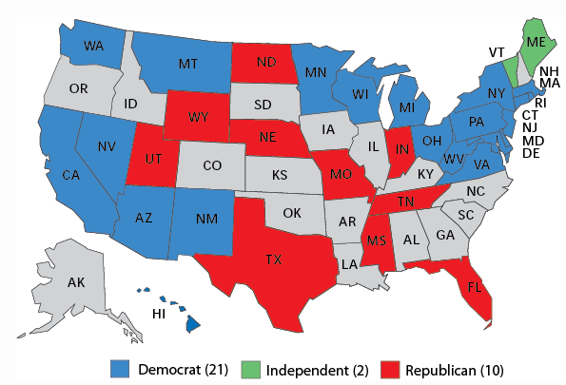
2024 SENATE ELECTION STATES FAVOR GOP
Brutal Battleground in ‘24 for Democrats

Slide 27
2024 HOUSE: TOO CLOSE TO CALL / TOO SOON TO TELL
By the Numbers
6,675
net total votes by which the GOP won the 2022 majority (5 closest races)
5
Net Democratic pick-ups needed to gain control
23
Members of the 118th Congress representing seats their party lost in 2020 (18R, 5D)
1952
the last time the House changed control in a Presidential election year
1954
the last time the House changed control after only one Congress

Slide 28
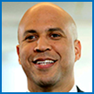
2024 CAMPAIGN: REMATCH?
Presumptive nominee… if running
Not
1st Tier Alternatives
Kamala Harris
Pete Buttigieg
Gretchen Whitmer
Ron DeSantis
2nd Tier
Amy Klobuchar
Gina
Raimondo
Gavin
Newsom
Bernie Sanders
Tim
Scott
Nikki
Haley
Mike
Pence
Asa
Hutchison
Phil Murphy
Cory Booker
Elizabeth
Warren
Alexandria
Ocasio-Cortez
Chris
Sununu
Kristi
Noem
Chris
Christie

Slide 29
TO RECEIVE FUTURE REPORTS: bruce@mc-dc.com

